Slide 1
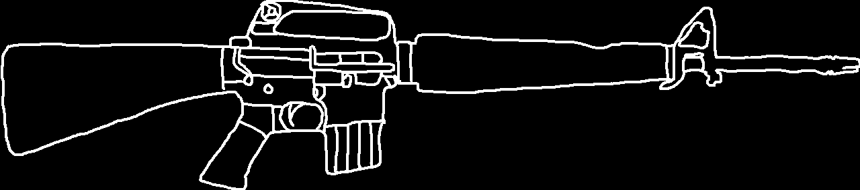
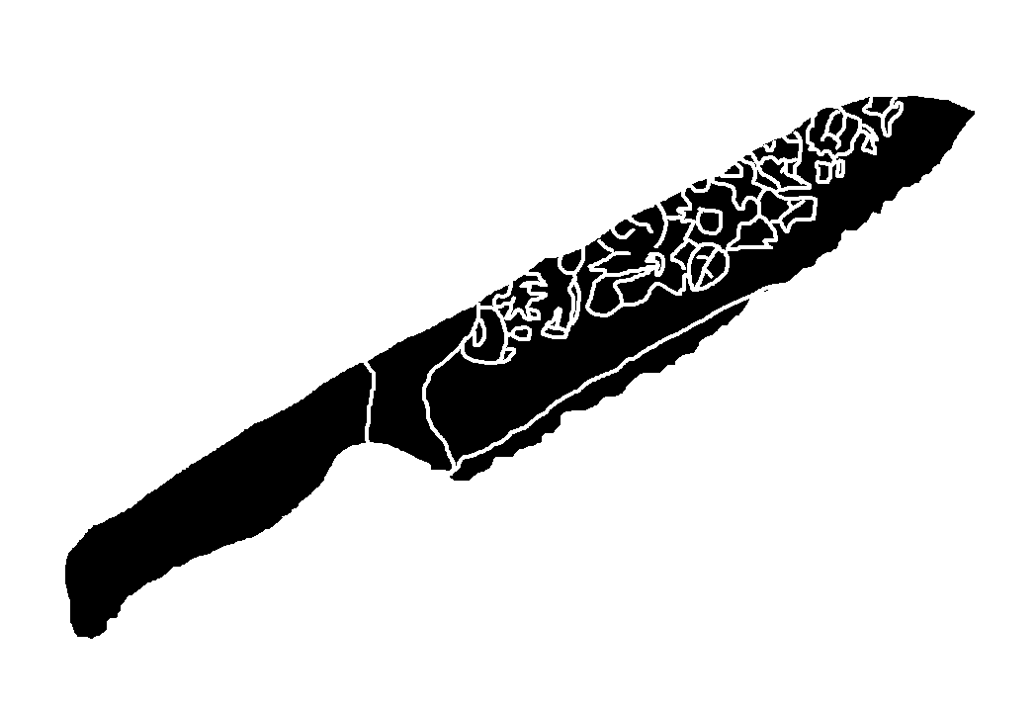
세계 제일의~ 장미칼!
Notes:
마동석

Slide 2
Notes:
Ready

Slide 3
How to deal with difficult people
Essay and presentation
Made by. 황준화
E
G
D
Notes:
Intro

Slide 4

8
3
4
2 persuasion
1
WA
YS
How to deal with difficult people
세계 제일의~ 장미칼!
command
4 threat
advise
Notes:
Index

Slide 5
Thank you for
4 threat

Slide 6
Thank you for
Listening
Playing
Enjoying
Doing
Going
Eating
Running
Shouting
이거
읽는
사람
있을까
Loving
Reading
Opening
Closing
Watching

